Slide 1


Slide 2

Simon Timms
Simon Timms
ASP.NET Monsters
Jack of all trades
blog.simontimms.com
@stimms

Slide 3


Patrick Ullrich
Regina, Saskatchewan
.NET Core + ReactJS
Outpost.Health
Healthcare, Digital Identity
@itspatricku

Slide 4





What are we going to talk about
Why APIs
Which Architecture
Why .NET Core
Introducing Tollbooth API
Common Mistakes and Solutions

Slide 5



Why APIS
The number of APIs in every day applications is increasing
Leverage 3rd party services using APIs
Communicate between different groups inside the same company using APIs
Notes:
Why are we talking about APIs?
1. APIs are everywhere and are essentially to most businesses, APIs that allow applications to talk with each other
2. Programmers from Junior to Senior are building APIs

Slide 6
What Architecture
Remote method invocation (Web Methods, CORBA, etc.)
Event Driven
SOAP
REST
GraphQL
Notes:
There are a number of techniques you can use to build out APIs. Some of them are better for internal systems, and some for external system. Way back in the day we use to use remote method invocation….
Talk about it being just the interface to your business logic

Slide 7
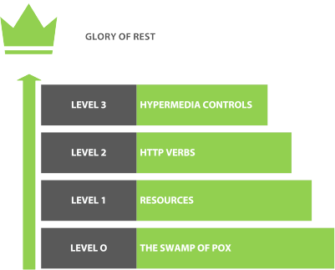
Rest Maturity
The Richardson Maturity Model describes 4 levels of building RESTful APIs
Each level is harder to achieve
Notes:
Talk about each level

Slide 8
Why .net core

Slide 9
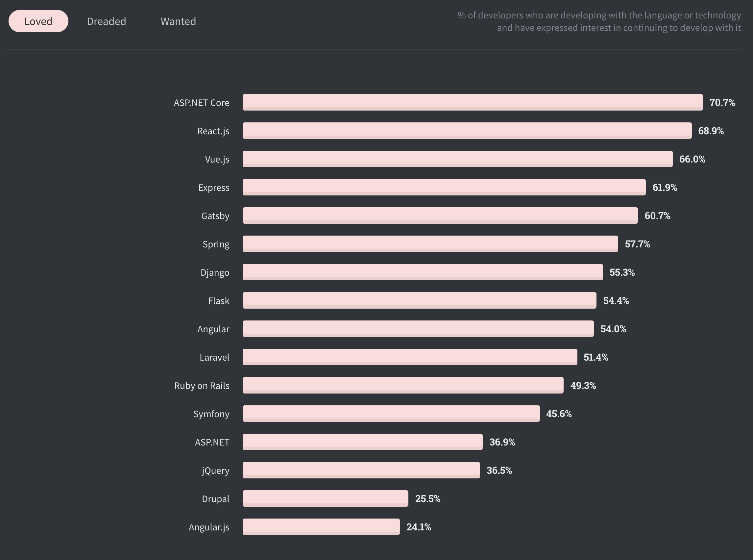
Most loved
Source: https://insights.stackoverflow.com/survey/2020#technology-most-loved-dreaded-and-wanted-web-frameworks-loved2

Slide 10
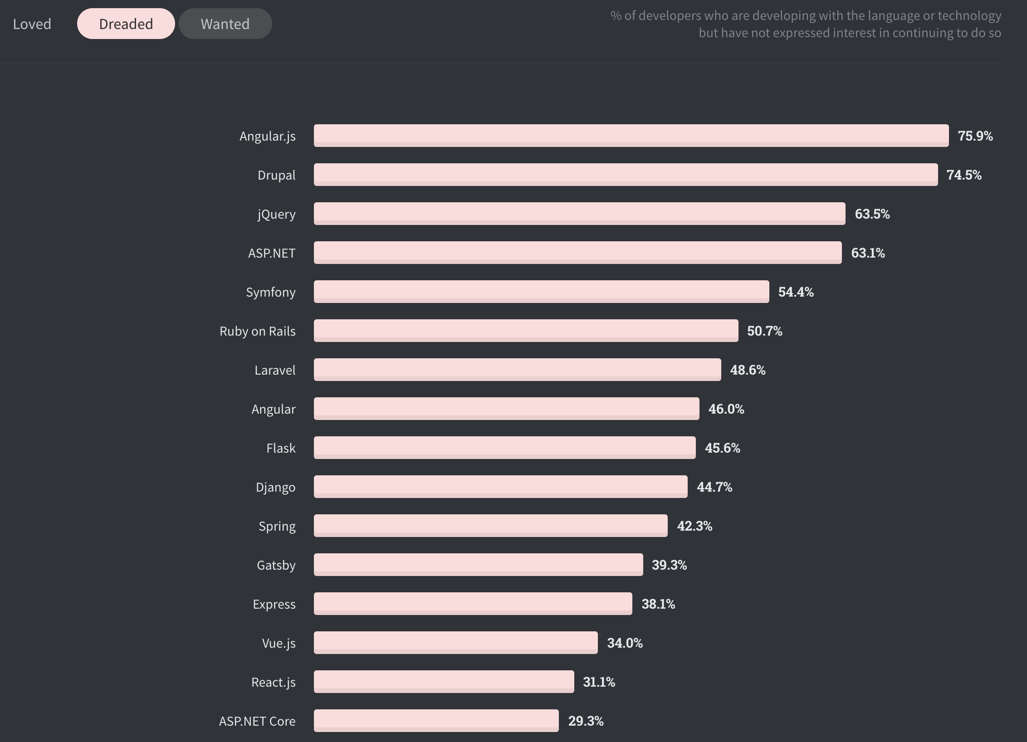
Least dreaded
Source: https://insights.stackoverflow.com/survey/2020#technology-most-loved-dreaded-and-wanted-web-frameworks-dreaded2

Slide 11
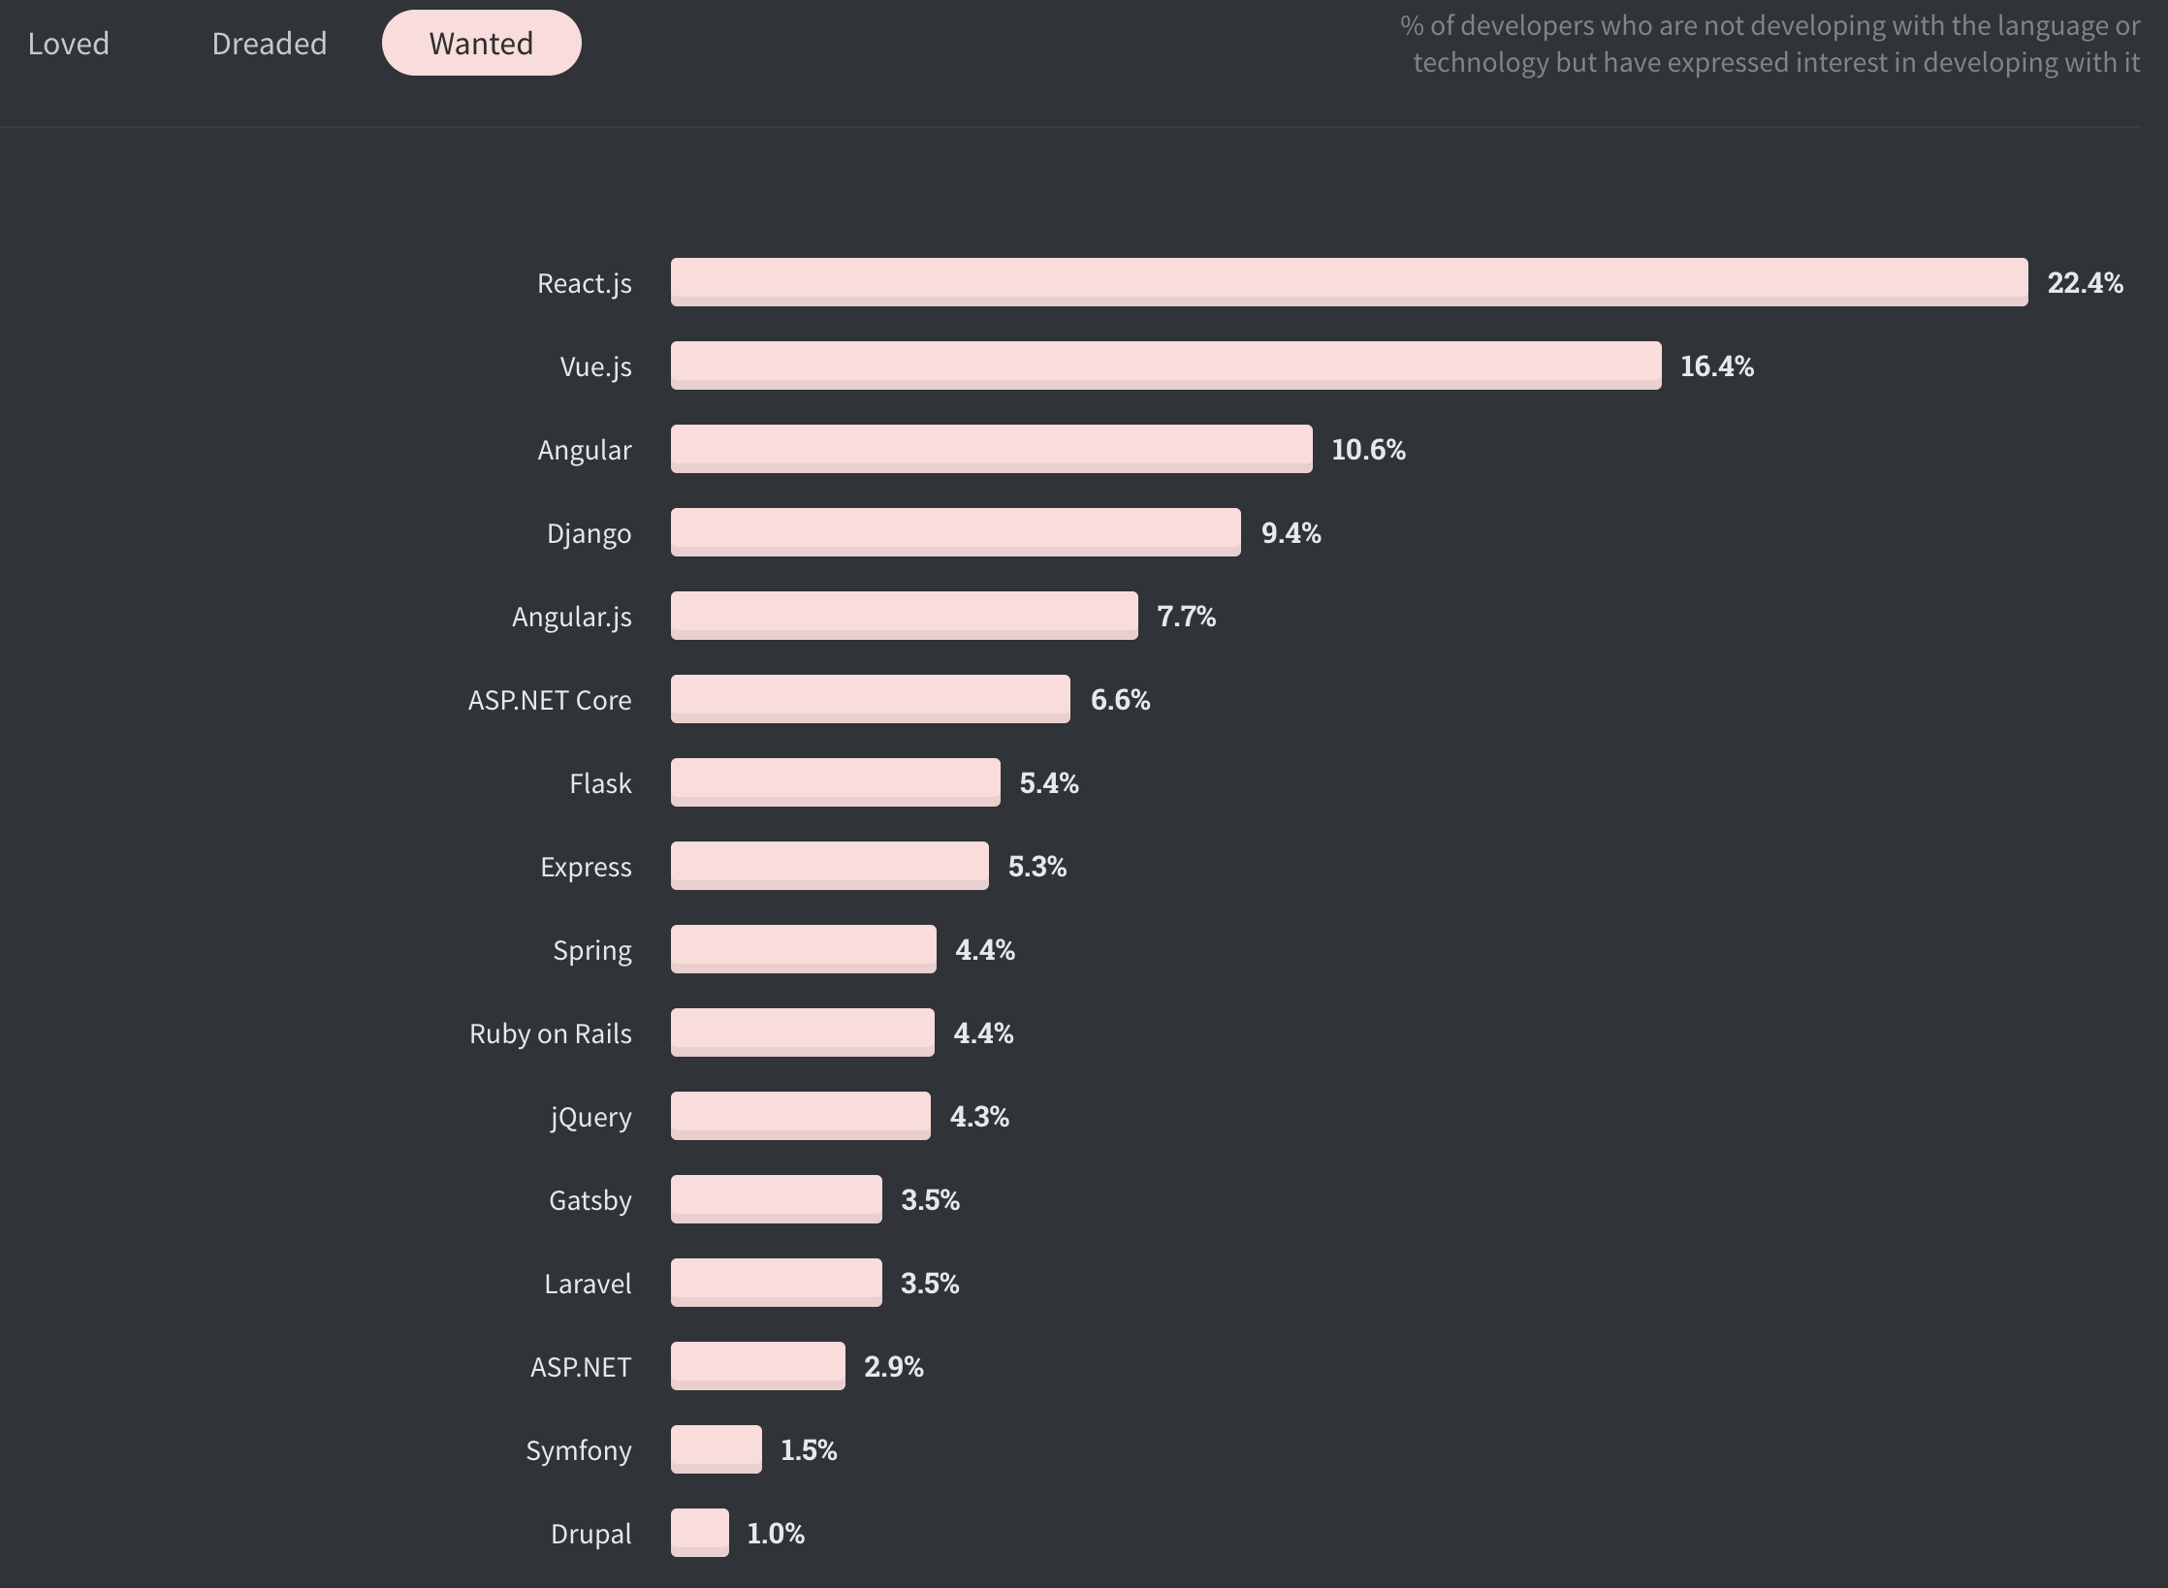
Decently wanted
Source: https://insights.stackoverflow.com/survey/2020#technology-most-loved-dreaded-and-wanted-web-frameworks-wanted2

Slide 12
.net Core
Lightweight
Fast
Flexible
Rich Eco System
Notes:
Can get started with just a few lines of code
High Performance
Can be deployed using IIS, Kastrel and many more, on essentially any OS
Rich eco system (.NET) and Nuget

Slide 13
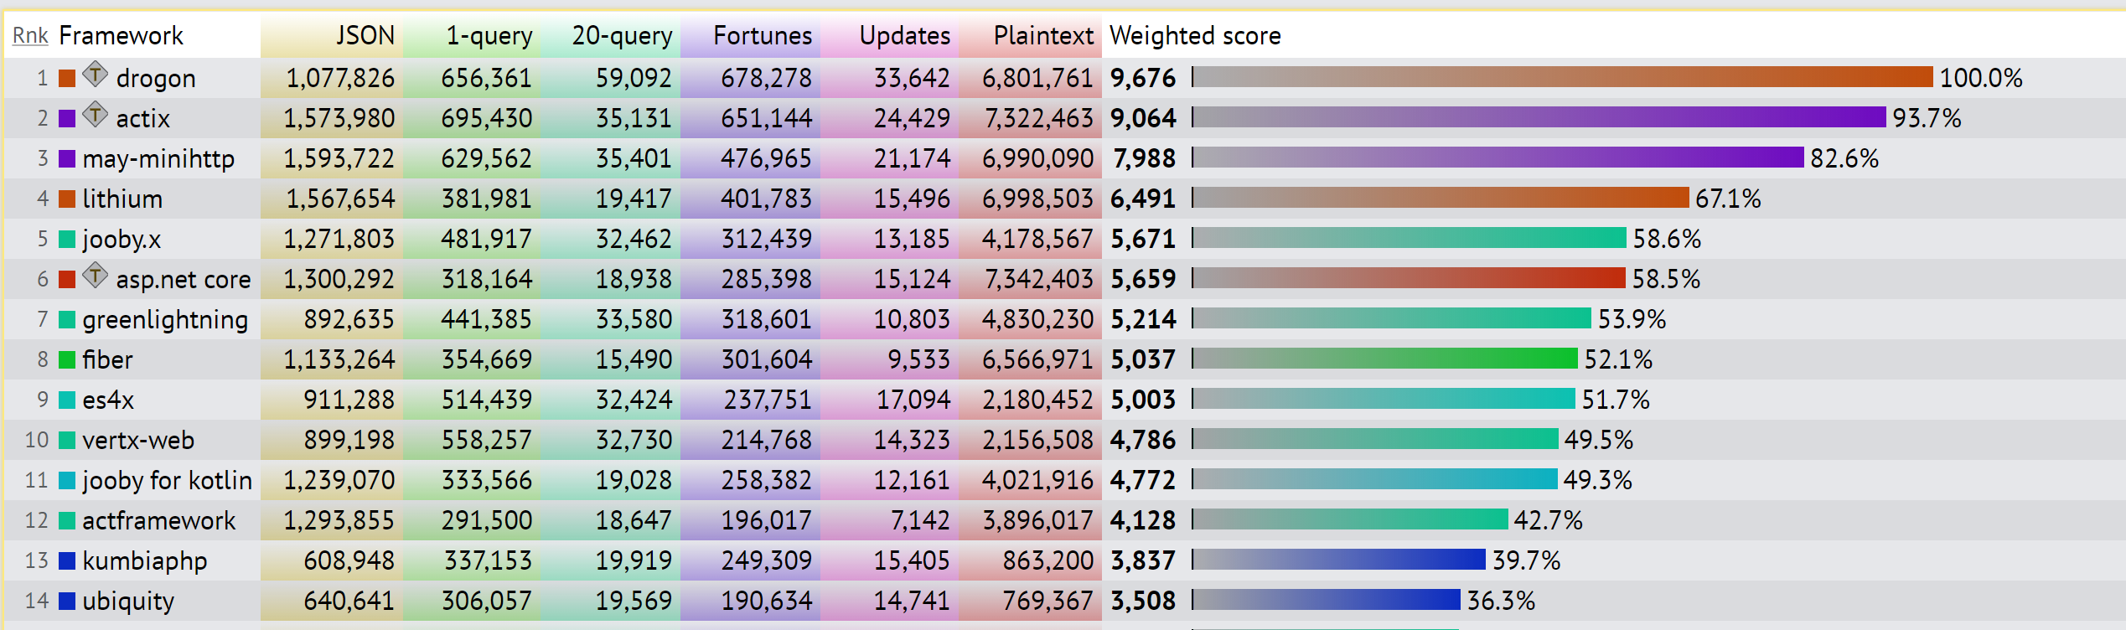
Blazingly fast

Slide 14

ASP.NET
Notes:
If asp.net were to be an old business man

Slide 15

NODE.JS
Notes:
And node js the rebelios teen

Slide 16

.NET Core
Notes:
Then asp.net core feels like the young professional entrepreneur, merging the best of both worlds

Slide 17
tollbooth
Demo
Notes:
Drop to visual studio and demo swagger

Slide 18







Issues with our tollbooth app
No Documentation
Bad Status Codes
No Insights into Application Health
No Security
No HTTPS
Data leaks
Confusing Unit Uses

Slide 19


Let’s fix it
Notes:
We now have our tools, lets get building

Slide 20
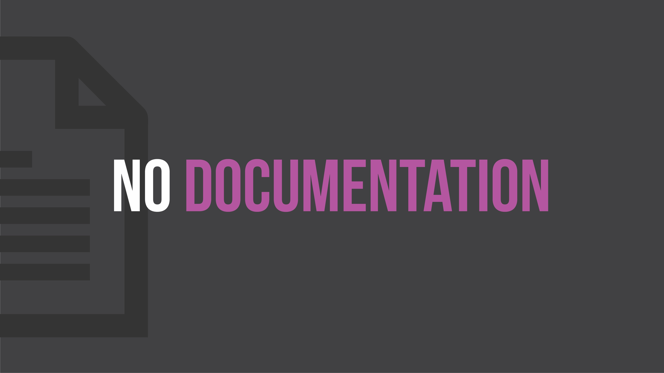
Notes:
This is something I commonly see in APIs: incorrect use of status codes

Slide 21
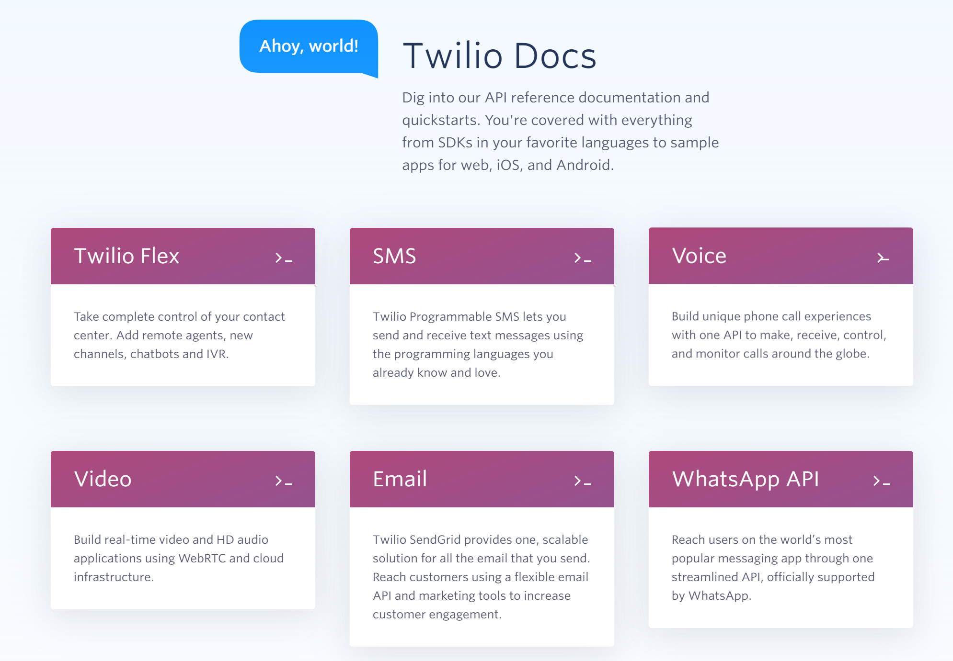
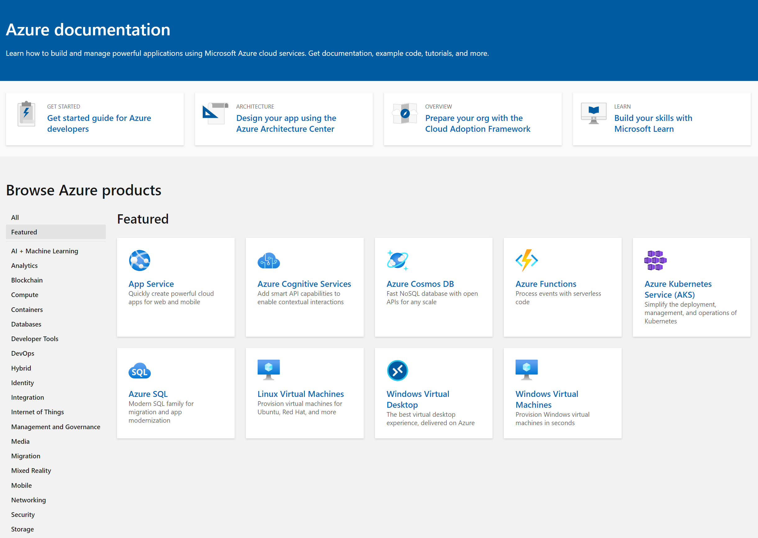
Start with amazing documentation
Notes:
If we want people to use our APIs and we do want that then the place to start is with good documentation. When I started programming Java was hot stuff and the docs for it were really good, considering it was 2000 and most people were still crawling out of the primordial ooze.

Slide 22
Openapi specification (formerly swagger)
API Description format for REST APIs
Generates Documentation (SwaggerUI)
Generate Server Stub (Swagger Codegen)
Generate client-side Libraries (Swagger Codegen)
Controllers are just a thin Presentation Layer – no logic -> great candidate to generate
Notes:
The leading industry standard is a specification called open api. It was called swagger which I felt was a way better name. open api is a way of documenting your apis in a way that can be used both by humans and by computers.

Slide 23
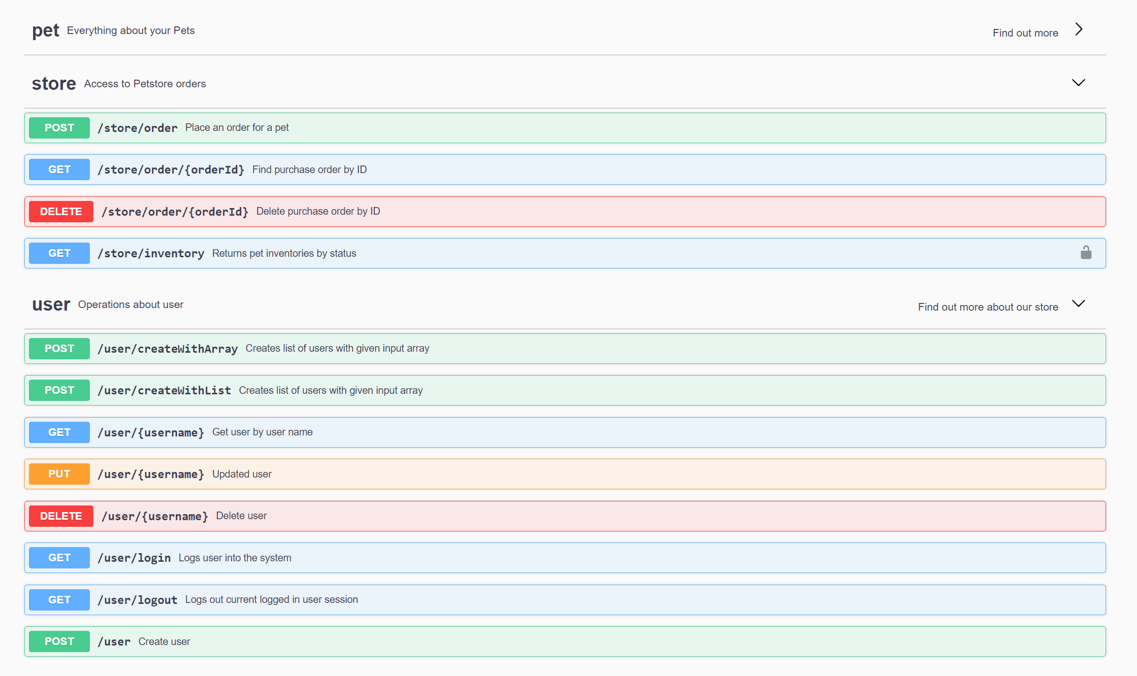
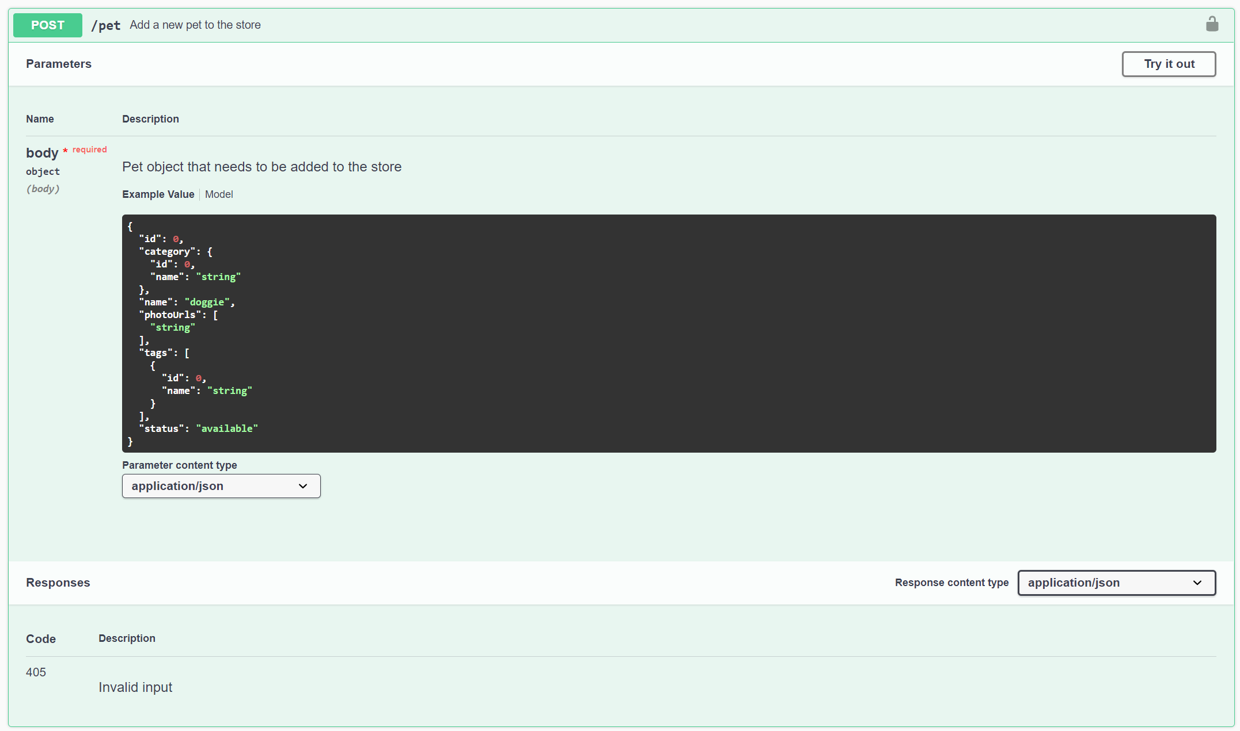
Swagger ui
Notes:
The swagger UI reads open api files and displays a handy visualization of each resource and the operations that you can perform on them

Slide 24
Swagger ui
Notes:
Drilling into one method we can see a sample body, the responses and parameters. You can even click on the try it out button to execute the api

Slide 25
Asp.net core swagger
Demo
Notes:
Drop to visual studio and demo swagger

Slide 26

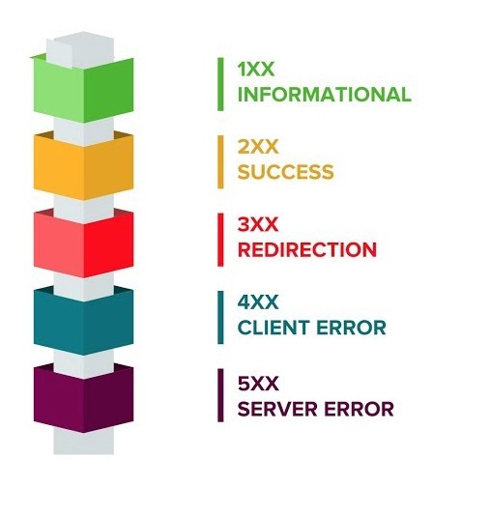
Status codes
Notes:
This is something I commonly see in APIs: incorrect use of status codes

Slide 27
Common, but incorrect, patterns
Return 200 for everything
Return 400 or 500 for every error
401 instead of 403 or vice versa
Return errors, without solution
Don’t be nice to bad people

Slide 28
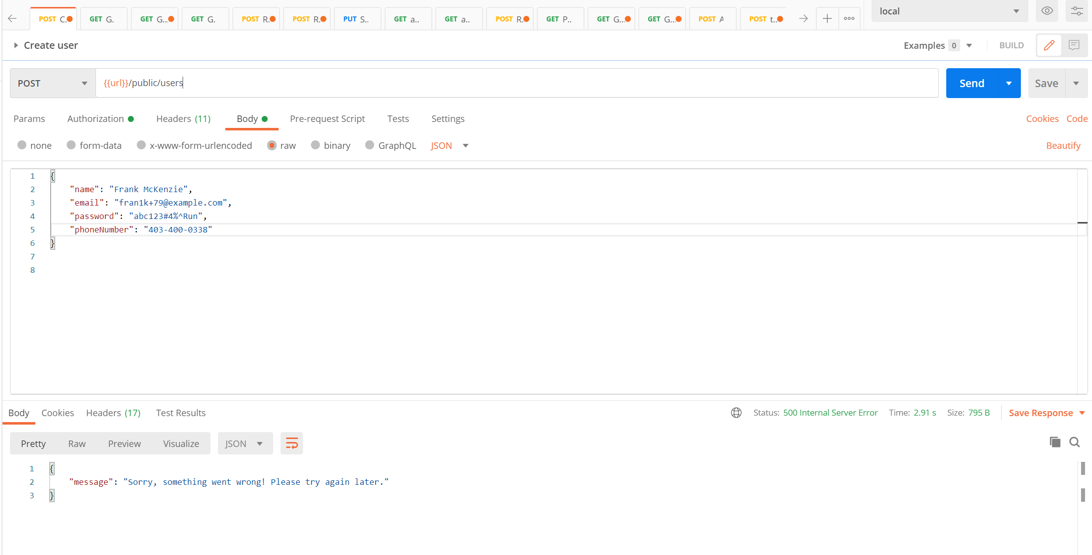
Return error messages inside of errors

Slide 29
Better Errors
Demo
Notes:
Add Error Handler Middleware
Add controller info on what errors will be returned (annotate)

Slide 30


Logging, logging, logging

Slide 31
Logging is
Instrumental in understanding the current state of production (I’d move this to app insights)
Detecting common errors
Catching errors as quickly as possible
Looking of unusual usage patterns
Catching performance issues
Tool for developers to fix error
Audit events

Slide 32
Add Logging middleware
Demo
Notes:
Just right click it in

Slide 33
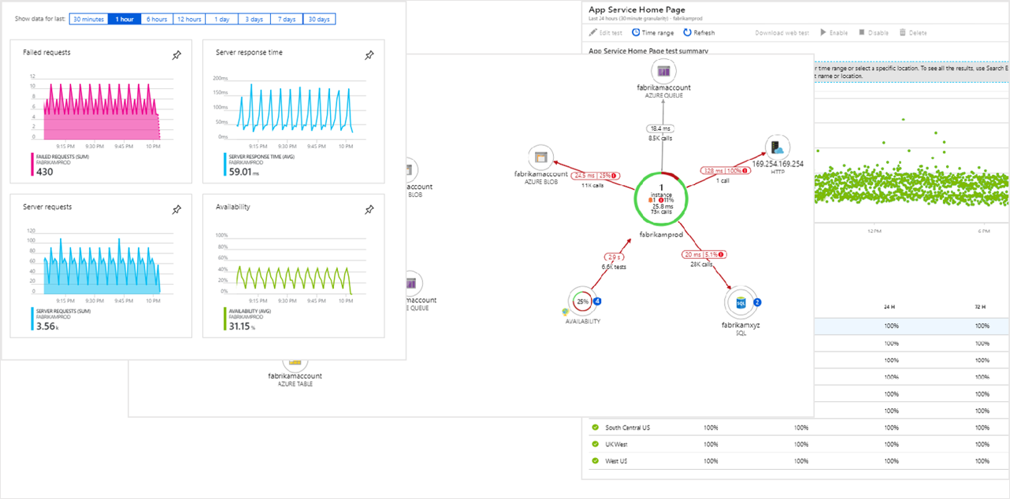
Gives you deep insights into your app
Notes:
Talk a little bit about some of the advantages of having logging in the application. Visibility into performance of requests, early warnings about errors, dig back in time and find when things went wrong. Answer questions like “did performance degrade with this release?” Mention the importance of log aggregation – correlating events from multiple sources, scaling out for multiple servers, gives you one place to go look for errors

Slide 34
Add application insights
Demo
Notes:
Just right click it in

Slide 35

Notes:
I’m not sure what this is a picture of but the caption said it is related to cyber security so who am I to argue?

Slide 36
Why add security
Gives us insight on
Who is accessing our API - Authentication
Restrict Content – Authorization
Allows to
Govern access e.g. Admin Screens
Monetizing content

Slide 37
Mechanisms for authenticating APIs
HTTP Authentication Schemes
Basic
Bearer
API Keys
OAuth2
Authorization Code
Implicit
Resource Owner Password Credentials
Client Credentials
OpenID
Notes:
Unlike a website we can’t provide an api with a popup asking for a user name and password. There are a few approaches for authenticating with APIs. The first is to use a preshared key. The second is to use OAUTH this uses another service to authenticate an api typically with a pair of keys and then pass a JWT or Bearer token to the api which then checks back with the OAUTH provider
HTTP Authentication Schemes: user can exchange username / password for a session token
API Keys: Keys exchanged prior, an exchanged secret
OAuth2, successor of OAuth1 is actually an Authorization Framework, manifesto is actually quite lengthy, most people probably think of it as using Facebook / github as login, has many different flows, including client credentials, that is a good match for Server to Server communication, and implicit for applications that do not have a backend. Involves an authorization server. Popular choice in the dot net world is Identity Server.
OpenID is built on top of OAuth2, is a authentication piece added into the oauth2 flow.
Api Keys is what we are using in this demo, purely because they are the simplest to implement and they are a great way to demonstrate on how Authentication Schemas work in .NET Core (Authentication Tickets)

Slide 38
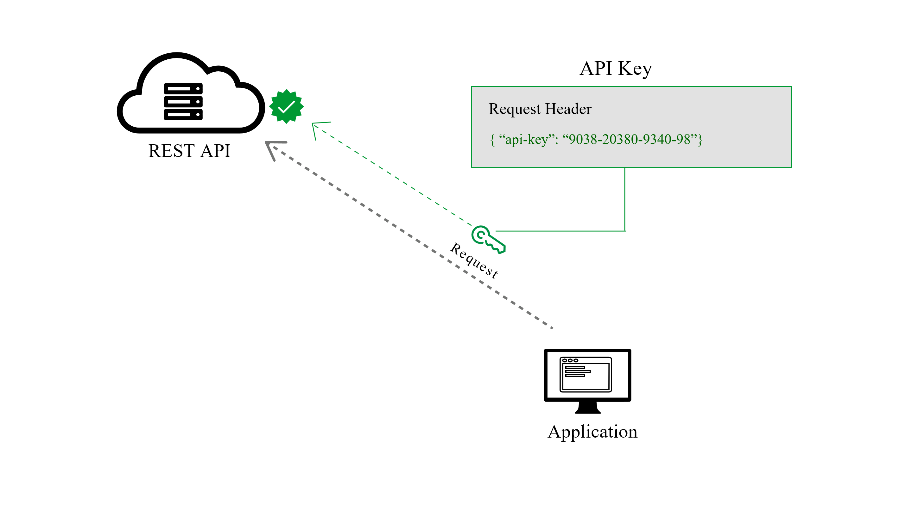
API Key
Source: https://dzone.com/articles/four-most-used-rest-api-authentication-methods

Slide 39
Authentication Concept in .Net core
Authentication Scheme
Handler
Options
Authenticate
Challenge
Forbid
Notes:
Authentication Scheme: Is the Authentication handler and Options, you usually just register 1 scheme, but you could have a default scheme and then have specific resources request specific schemes
Authentication Handler: Implements behavior of the Scheme, it’s job is to create a AuthenticationTicket that represents the identity of the request going forward. Alternatively it can return fail or noresult if authentication fails.
Authenticate: Responsibility to figure out requests identity. For example by looking at JWT bearer token or in our case validate an API Key
Challenge: Responsibility to handle an unauthenticated request e.g. failed authentication
Forbid: Responsibility to handle a unauthorized request. Let the user know that they don t have the right permissions

Slide 40
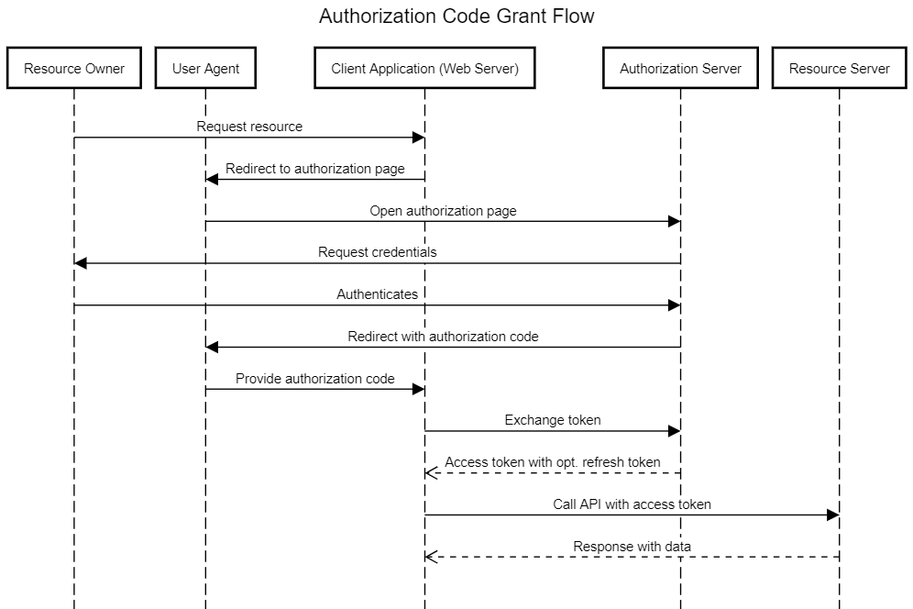
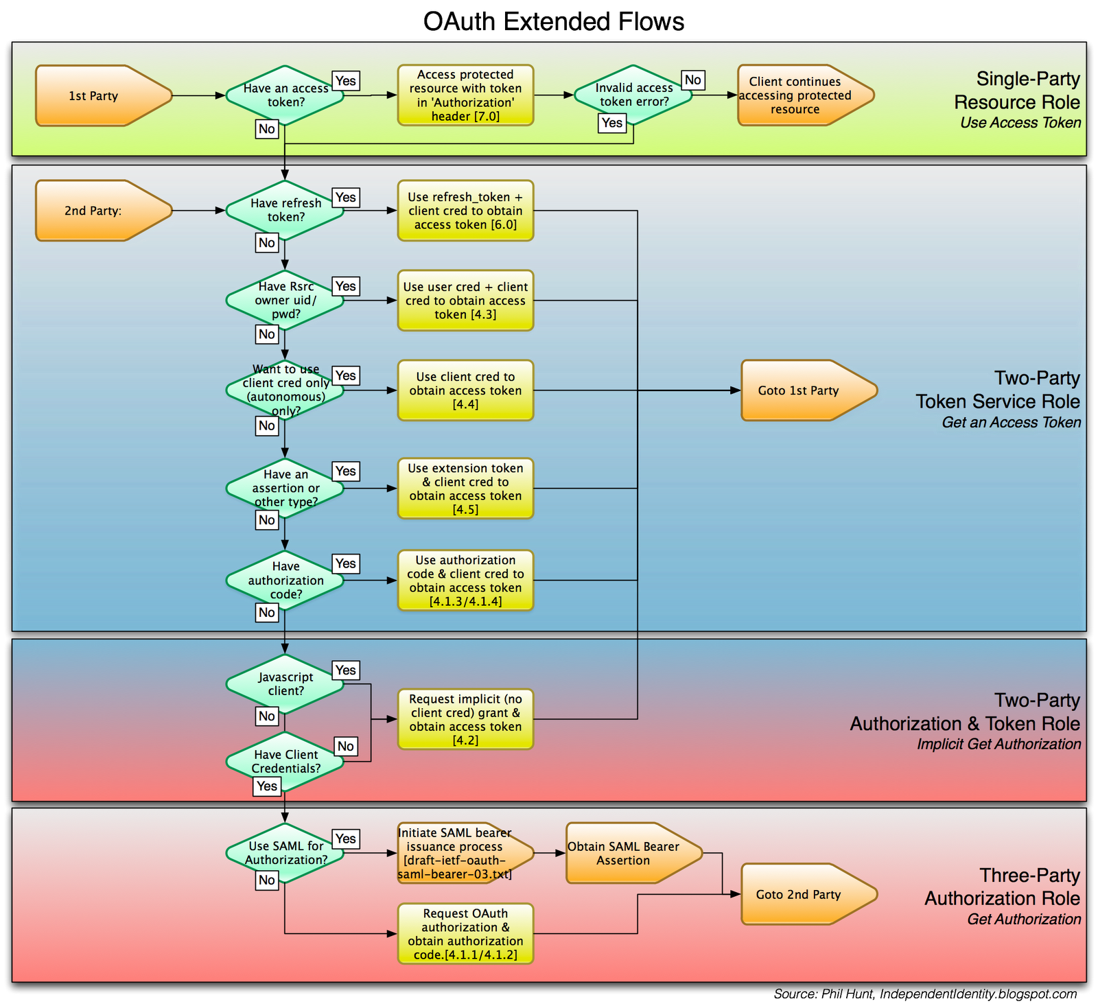
Oauth flows
Notes:
My biggest problem with OAUTH is that it is kind of complicated. If you search for diagrams of oauth you get things like these which look complicated. There are, however, some really good turorials now for it
Should we delete this slide?

Slide 41
Adding API keys
Demo
Notes:
Just right click it in

Slide 42


Slide 43
HTTPS
What to do
Pay or Acquire free Certificates (AWS, Let’s Encrypt)
Auto redirect to HTTPS
Why
Combat Man in the middle attacks
Improve Search SEO
“Not Secure” Warning in browser
More new features require HTTPS (Service Workers, getUserMedia())
There is no excuse for not using HTTPS

Slide 44
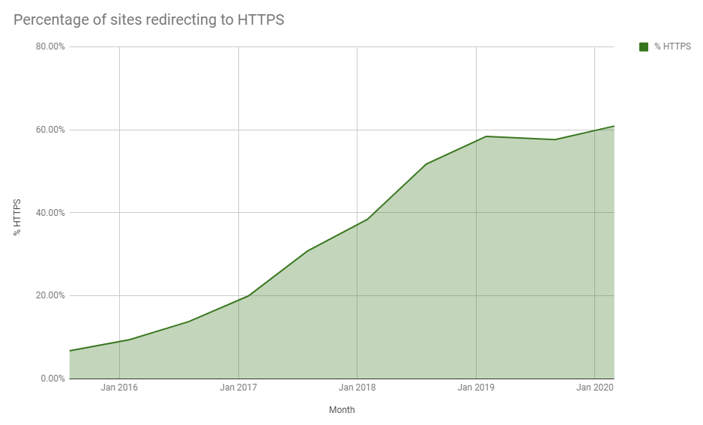
https adoption is growing

Slide 45
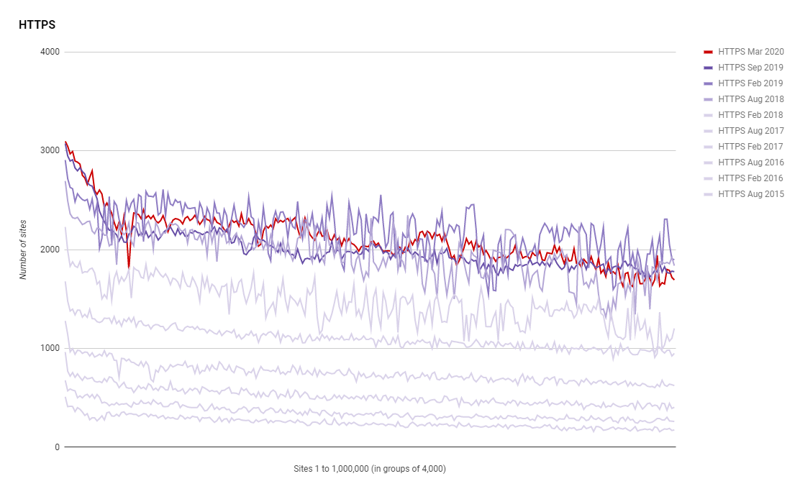
Every year the number of sites increases
Notes:
60.93% as of March this year

Slide 46
Auto Redirect to https
Demo
Notes:
Just right click it in

Slide 47


Slide 48
DTO
Demo
Notes:
Just right click it in

Slide 49
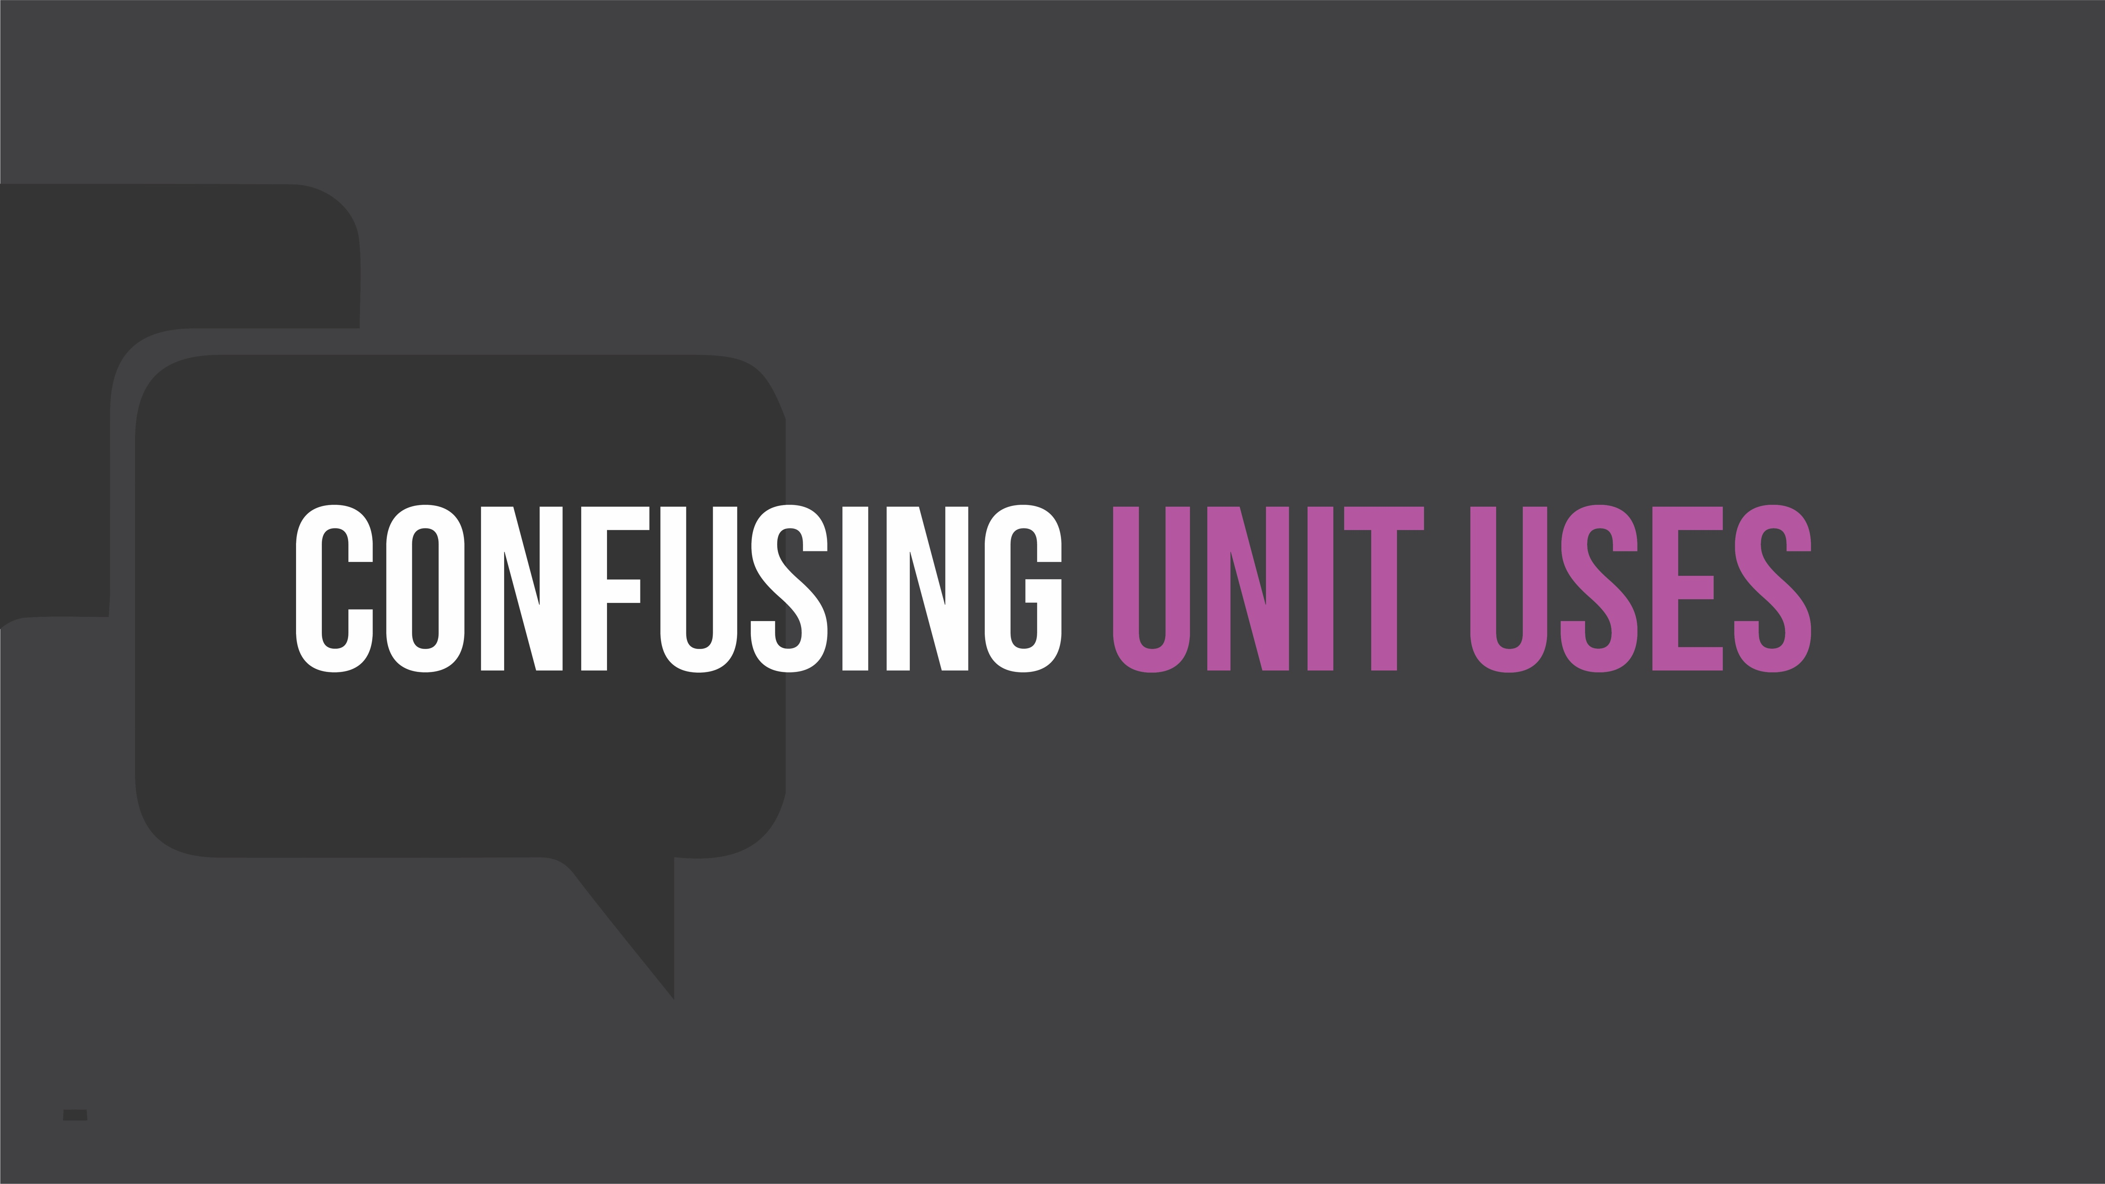

Slide 50
Put thought into the content of your messages
Use numbers when the field is a number
Use consistently formatted dates
Include the name of units in your field names
Flatten your messages and avoid unnecessary wrappers

Slide 51
Enforcing api standards with analyzers
Demo
Notes:
Just right click it in

